Slide 1
Performance Management End-of-Year Review

Slide 2
Housekeeping items
Session is being recorded.
Use the chat box to ask questions at any time.
Please silence phones and minimize background noise.
Inform your co-workers that you’re attending this session.
Please Note: If you are in a room with multiple people, please send a list of participants to Jen Clouser at jel33@psu.edu.

Slide 3
Today will help you to
Prepare for the end-of-year review meeting
Utilize Workday to document your employee’s performance
Identify your role and responsibilities in this process
Identify opportunities for your employee’s future growth and development

Slide 4
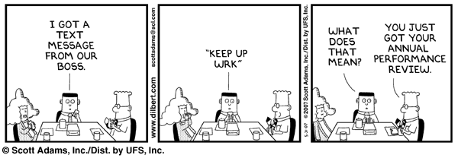

Slide 5
What is performance management?
The process of setting expectations, aligning goals, assessing results, and focusing on staff development through ongoing conversations between managers and their direct report(s).
Setting Expectations
Goals and Objectives
Goal Alignment
The process of discussing what is expected from an employee in terms of job roles and responsibilities.
Desired results each employee aims to achieve, based on conversations between managers and employees.
Process of ensuring individual goals will support the achievement of department goals and department goals support the achievement of University goals.
Assessment
Performance Calibration
Feedback and Development
Feedback and Development
Review of role, goals, and competencies by determining the level of successful achievement.
Process in which supervisors at the same level in an organization discuss staff performance ratings and outcomes to ensure ratings and development messages are applied consistently across the University.
Focus conversations between supervisors and employees in determining strengths, opportunities for improvement, and how to grow and develop.

Slide 6
Performance Management Cycle
STEP ONE: Setting Goals & Expectations |  |  | STEP TWO: Mid-Year Check-In |  | STEP THREE: End-of-Year Review
Ongoing Conversations between staff members and their supervisors throughout the year;
Staff member meets with manager to discuss expectations and set 2-5 goals for the performance management cycle. Staff member enters goals into Workday. Staff member reviews Job Responsibility and makes updates, if applicable; manager reviews and approves JRW. LEADERS HR Strategic Partners provide leadership teams the performance results from the previous year. Leadership teams meet to discuss ratings and agree on norms; norms are shared with staff members during the goal setting process. |  |  | Review goals and progress (make adjustments as needed). Check-in: review expectations and acknowledgement of successes and challenges. Staff member and manager enter notes from the Mid-Year Check-In meeting into Workday. |  | PREPARATION: Staff member completes self-evaluation in Workday. Optional: staff member and manager obtain feedback from others (e.g., peers, customers, etc.) outside of Workday; primary manager can invite an additional manager to give feedback on the review via Workday. Manager reviews and summarizes performance feedback for staff member in Workday. Peer managers conduct ratings calibration meetings (two levels). DELIVERY: Staff member meets with manager to discuss end-of-year review and receive an overall rating of their performance; acknowledgement of meeting occurs in Workday. Staff member and manager begin to discuss next year’s goals and development opportunities.
Recommended Timing: June 1 – August 31, 2018 |  |  | Recommended Timing: November 1 - December 31, 2018 |  | Recommended Timing: April 1 - May 31, 2019

Slide 7
Program Components
Content Area | Focus | Examples
Annual Goals | What do we need to accomplish this year in order to support my department’s goals? | Transition all budget records from old to new tracking system by March 31, 2019.
Competencies & Behaviors | What specific competencies and behaviors will help me accomplish my job responsibilities and achieve my goals for this year? | Communication: Fosters open dialogue and actively listens to others in order to build and maintain effective and respectful working relationships throughout the University.
Values & Compliance | I have read and understand the PSU Values and my obligations under AD88: Code of Responsible Conduct. AND I understand my compliance obligations and have completed the associate required compliance training(s) for my position. | Completion of compliance training such as: Annual Compliance Training (ACT), Building a Safe Penn State: Reporting Child Abuse Training, Clery Act Training (for CSAs), Understanding Title IX, Information Security Awareness, Etc.

Slide 8
Checklist
Feedback from you as a Manager
Receiving feedback as a staff member
Do you provide clear expectations?
Do you communicate your assessments?
Do you hold back because of fear of staff member’s response?
Do you feel that feedback is a burden?
Are your conversations thorough?
Do you provide feedback promptly?
How often do you ask for feedback?
Do you ever get defensive?
Do you ask for more detail?
Are your conversations thorough?
Do you ensure that expectations are clear?
Do you set goals for improvement?
Do you follow up to get additional feedback on progress?
Notes:
Provide feedback ON-GOING to your employees– throughout the year– formally and informally
Plan your feedback
No surprises- especially during the End-of-Year Review

Slide 9
Prior to writing the review
Consider the following questions:
What has the employee accomplished this year?
Do those accomplishments meet the goals that were agreed upon?
How is the employee utilizing each core competency?
What is the employee doing that is highly effective?
Is there anything getting in the way of their success?
Overall has the employee been successful during the performance management cycle? If not, what can you do to help change this?
Notes:
The goal of these questions is to be clear and specific with feedback instead of vague and unclear.

Slide 10
Vague vs Specific
Vague: You do a great job running meetings.
Specific: Everyone on the team appreciates the way you facilitate meetings. You identify the areas in which we have conflict, you summarize the points before we move on, and you maintain a positive environment for everyone to share and be heard.
Vague: You’re a terrible communicator.
Specific: When you send out your monthly marketing plan updates/next steps, you tend to be too wordy and vague regarding next steps, which leaves your team confused with what they are being asked to do and what they will be held accountable for.

Slide 11
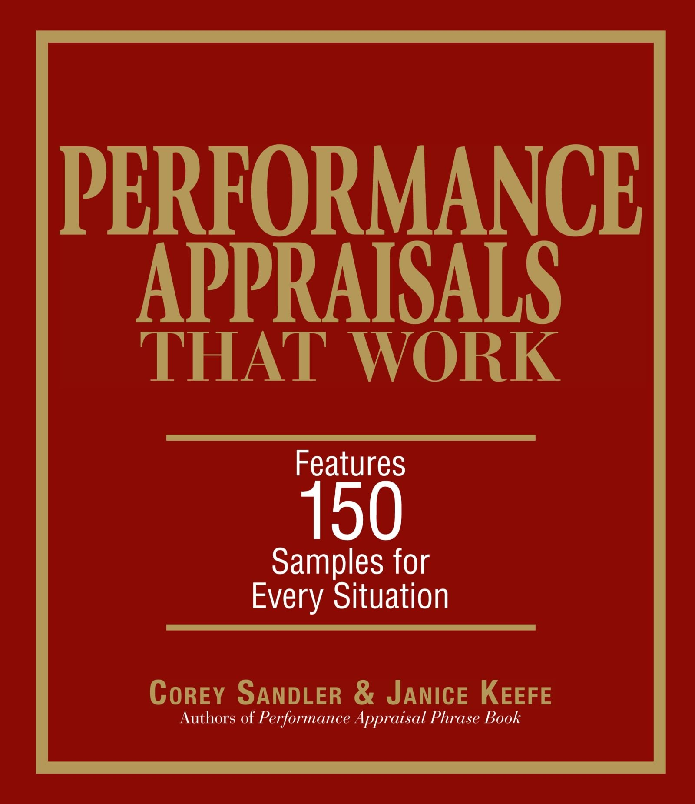
Tip: Use Reference Books

Slide 12
Ratings Scales
Individual Components
Rating | Description | Example
Exceptional Contributor | Demonstrates and applies exceptional level of knowledge and skills. Consistently excels. Significant achievement relative to goals. | Sets goal to cut department expenses by 10%, cuts by over 12%.
Successful Contributor | Demonstrates the appropriate level of knowledge and skills. Performs effectively and consistently. Achieves goals. | Sets goal to cut department expenses by 10%, cuts by 8-12%.
Needs Improvement | Demonstrates a lack of knowledge and/or skills. Does not perform consistently. Does not achieve goals. | Sets goal to cut department expenses by 10%, cuts by less than 8%.
Overall Evaluation
Rating | Description | Example
Exceptional Contributor | Consistently strong in the majority, if not all, individual evaluation components. Exceeds goals and job requirements; goes above and beyond to demonstrate behaviors. | Viewed as “Exceptional” on almost, if not all, goals, behaviors, and job responsibilities; “Successful” in remaining program components.
Successful Contributor | Consistently proficient in individual evaluation components; may be strong in several areas. Meets goals and job requirements; consistently demonstrates competencies & behaviors. | Viewed as “Successful” on most goals, behaviors, and job responsibilities; may be “Exceptional” in several areas; may receive a few “Needs Improvement” ratings on individual goals/behaviors.
Needs Improvement | Needs improvement in most individual evaluation components. Does not meet goals and fails to satisfy job requirements; does not demonstrate competencies & behaviors. | Receives a “Needs Improvement” on a majority of goals, behaviors, and job responsibilities; may be “Successful” in a few areas.
Notes:
The three-rating scale is simple to communicate and allows for honest communication of employee effectiveness while maintaining flexibility to differentiate performance.

Slide 13
Completing the Overall Rating
Is it realistic to give everyone on your team an “Exceptional Contributor” rating?
Exceptional Contributor
Successful Contributor
Needs Improvement
Needs Improvement
Successful Contributor
Exceptional Contributor

Slide 14
Needs Improvement Rating
Don’t sugar-coat or avoid the bad news.
This is your opportunity to address poor performance and correct poor attitude/behavior.
You’re not doing your employee any favors by being dishonest about the employee’s performance.

Slide 15
Errors to Avoid
Error | Description
Recency Effect | Reviewing only the most recent performance and not taking into account events throughout the entire year.
Halo Effect (Lenience) | Allowing excellent performance in one area to overshadow the review of performance in other areas.
Horns Effect (Harshness) | Allowing unsatisfactory performance in one area to overshadow the review of performance in other areas.
Central Tendency | Selecting a middle or average rating to describe all performance; lack of differentiation among employees.
Low Tolerance | Rating everyone low because of excessively high standards.
High Tolerance | Rating everyone high in order to avoid conflict or hurt feelings.
Lack of Information | Making evaluations with incomplete information.
Avoidance | Reluctancy to discuss problem.
Contrast | Performance-rating error in which an employee’s evaluation is biased either upward or downward because of comparison with another employee just previously evaluated.

Slide 16
Most Important Question
How can I help you be more successful in your role?

Slide 17
Manager End-of-Year Review Checklist & Utilizing Workday
Review Checklist
Launch Tutorial

Slide 18
To Do
Encourage your employee(s) to attend a training session about preparing for their End-of-Year Review.
Ask your employee(s) to complete their self-appraisals in Workday in a timely manner.
Optional: Solicit feedback from a dotted line manager (in Workday) or others (outside of Workday regarding your employee’s performance).
Write the review(s) in Workday and arrive at an overall rating.
Schedule time to meet with your employee(s) for their End-of-Year Review.
Acknowledge in Workday that the end-of-year review conversation occurred and that the overall rating was shared with your employee(s).
Notes:
Remember! The End-of-Year Review conversation should be a brief summary of what was– and then move into a future-based conversation regarding next year’s goals and opportunities for growth and development.
Feel free to ask for feedback from others who would be able to offer comprehensive and helpful information from their interactions with each of your employees.
se the employee’s self-appraisal as a data source!

Slide 19
Developing Your Employees
As a manager it is important that you:
Support the growth and development of all employees within your department, regardless of role.
Are aware of each employee’s strengths, developmental areas, and career goals.
Utilize the 70-20-10 approach for employee development
70% of development comes from on-the-job experience
20% of development comes from relationships, networking, observing others, etc.
10% of development comes from formal training opportunities.

Slide 20
Effective Performance Management
Helps to:
Target critical talent for development and retention.
Execute strategy by prioritizing and aligning goals and objectives.
Improve performance of groups and individuals.
Make better pay decisions based on performance and desired results.
Identify top performers to develop a succession plan.

Slide 21
Jen Clouser Human Resource Specialist Talent, Diversity, & Inclusion
jel33@psu.edu

